Slide 1
Our Fathers
And Our Father Figure Role Models
June 16, 2024

Slide 2
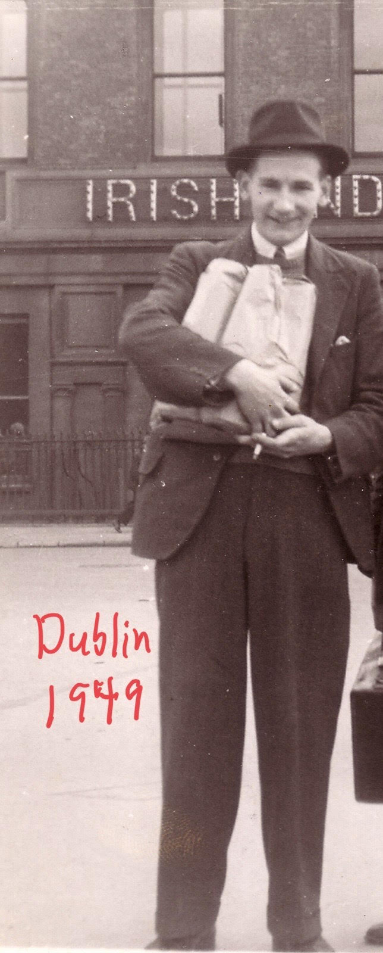
Fr. Paul McAuley’s Father

Slide 3
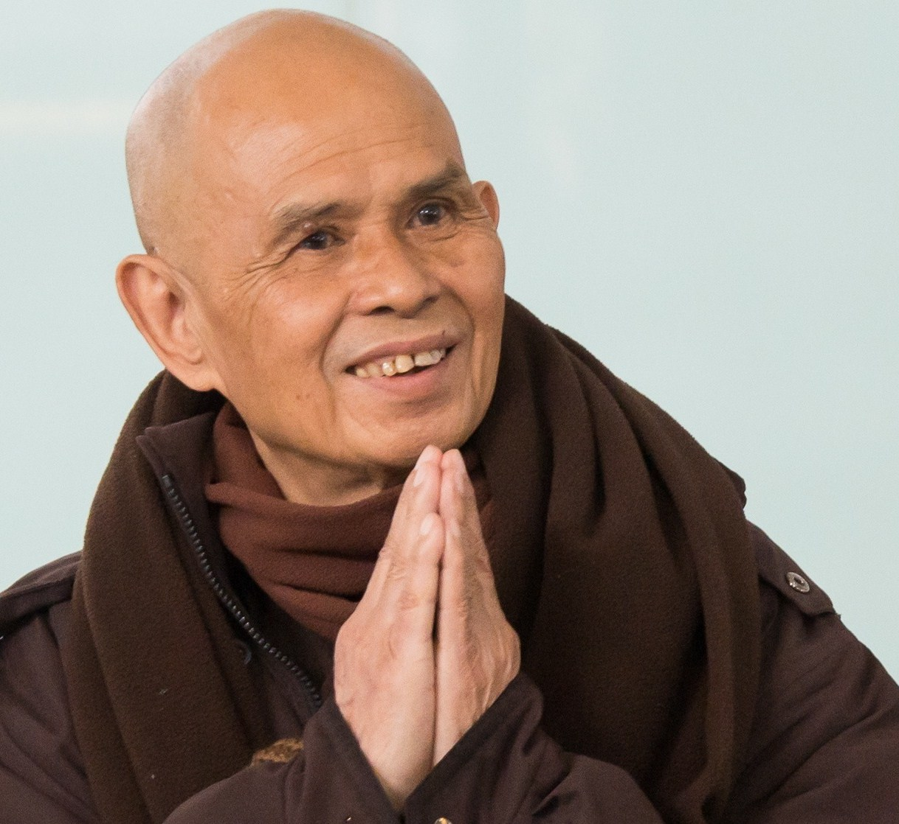
Thich Nhat Hanh

Slide 4
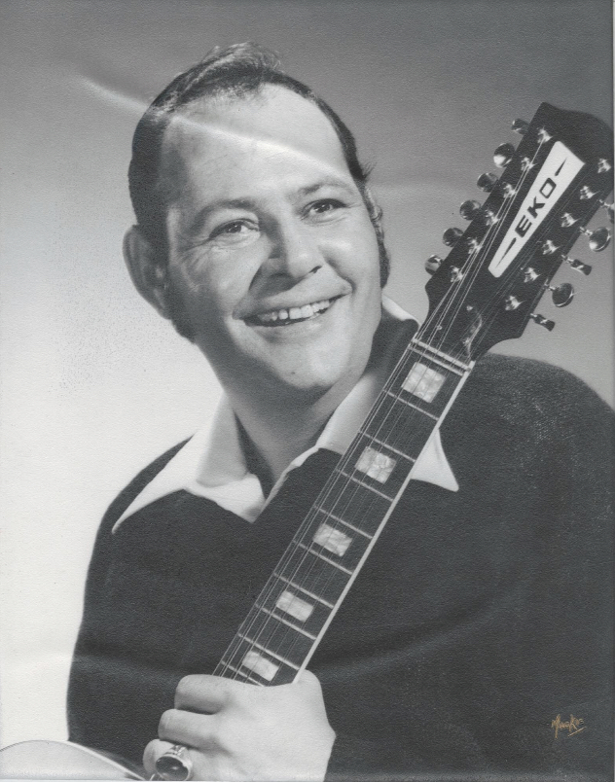
Lance Burnett Riley: Dean

Slide 5
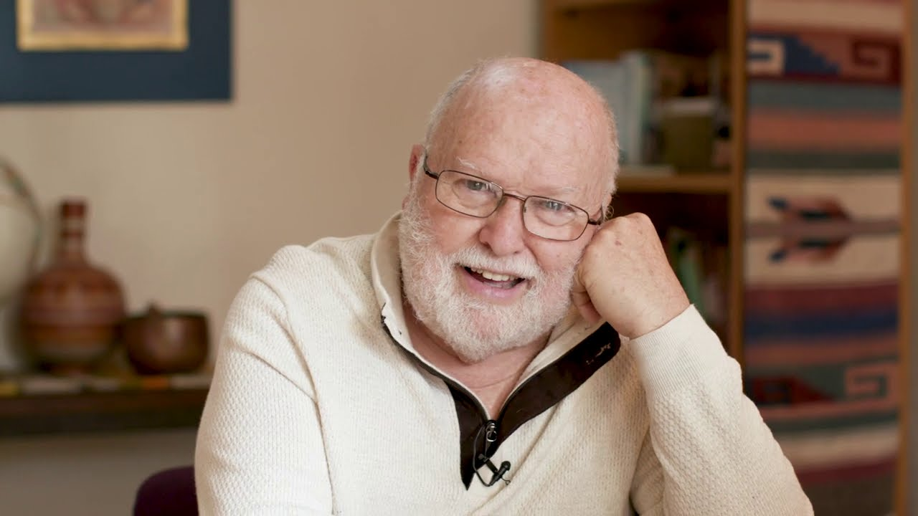
Richard Rohr

Slide 6
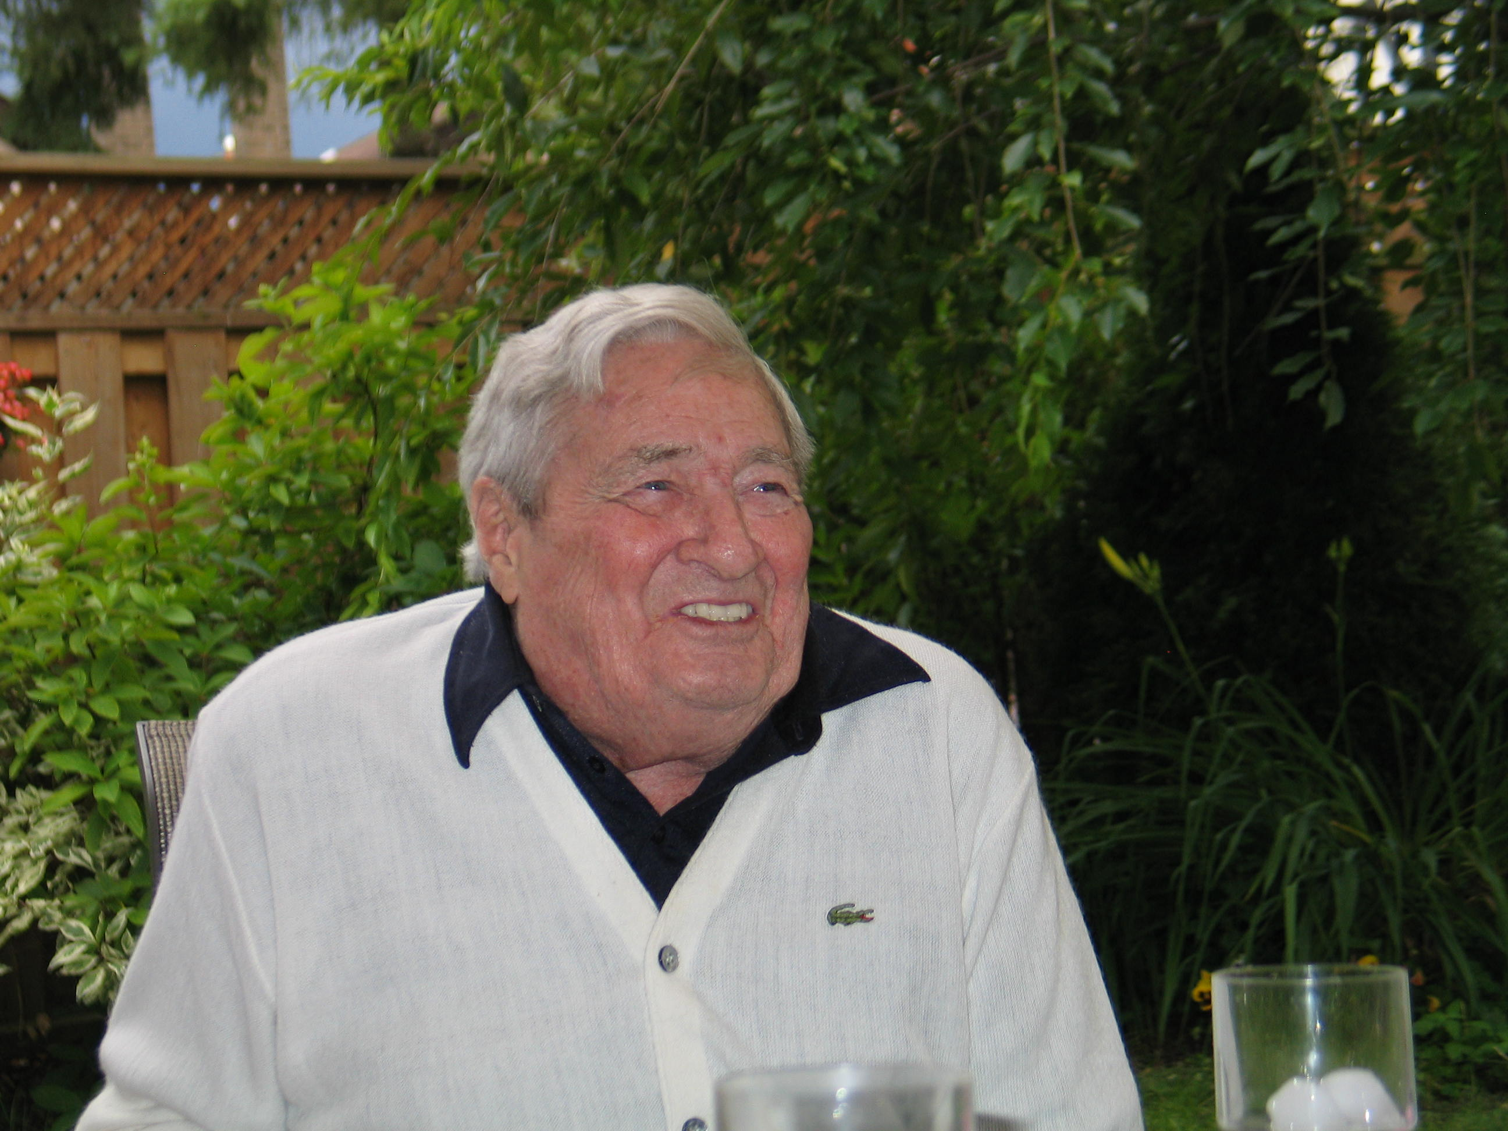
Richard (Dick) Foss: Lindsay

Slide 7
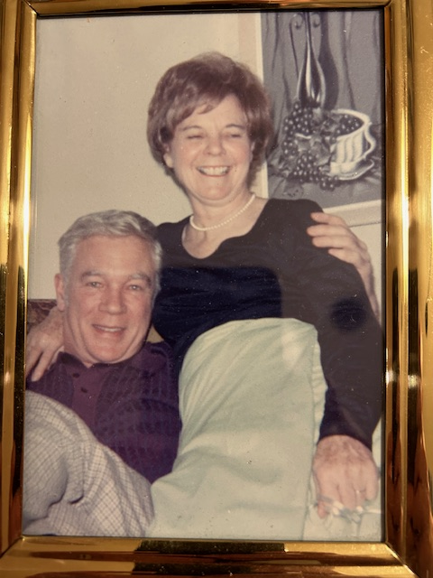
Robert (Bob) & Cecelia (Teah) Watson: Bill

Slide 8
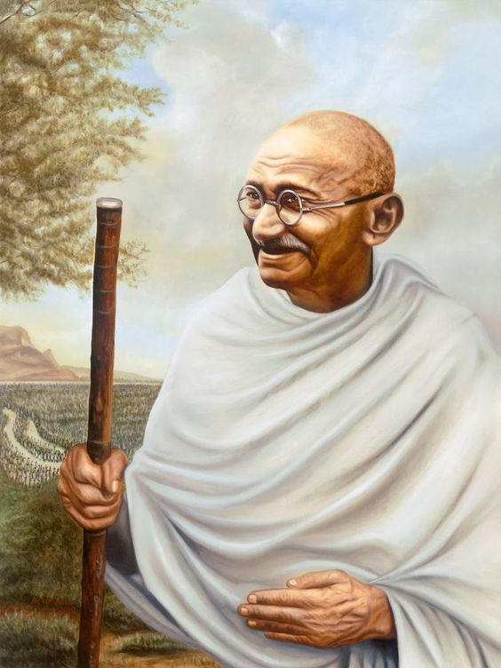
Mahatma Gandhi

Slide 9
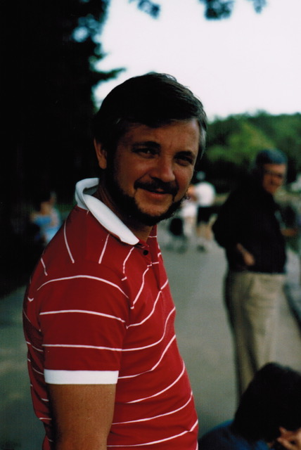
Bill Watson: Mike

Slide 10
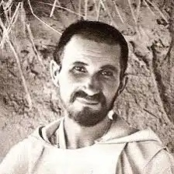
Charles de Faucauld

Slide 11
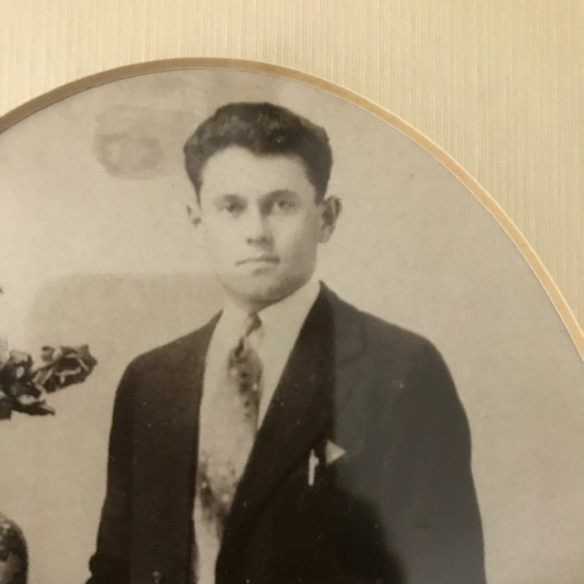
Antonio Vettor: Rita

Slide 12
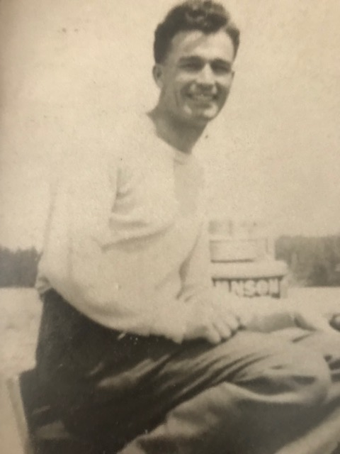
Lawrence Robert Shaughnessy: Brian

Slide 13
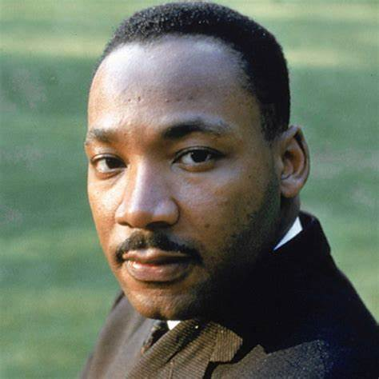
Martin Luther King Jr.

Slide 14
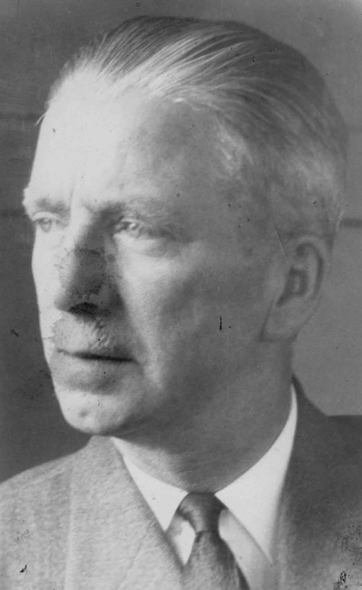
Tom Dalton: Mary Lou Halferty

Slide 15
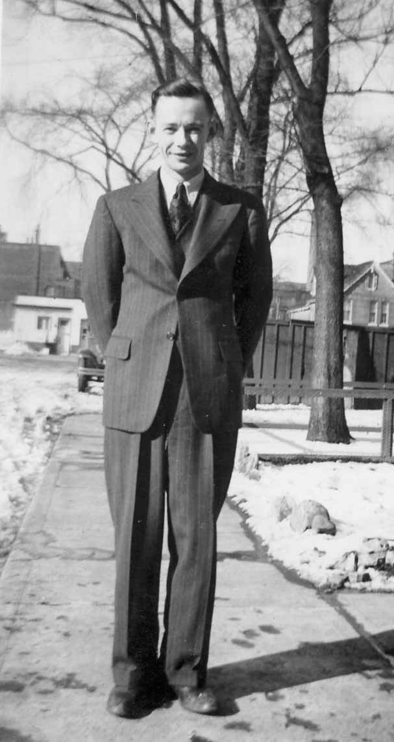
Lorne Halferty: Brian

Slide 16
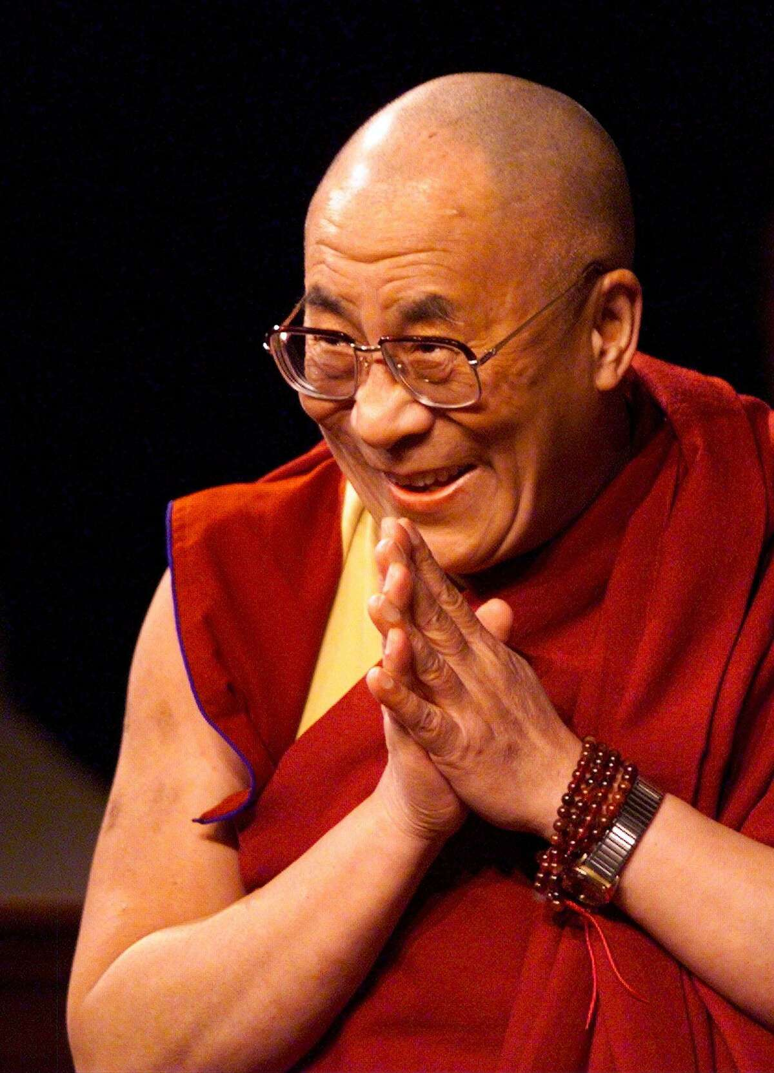
Dalai Lama

Slide 17
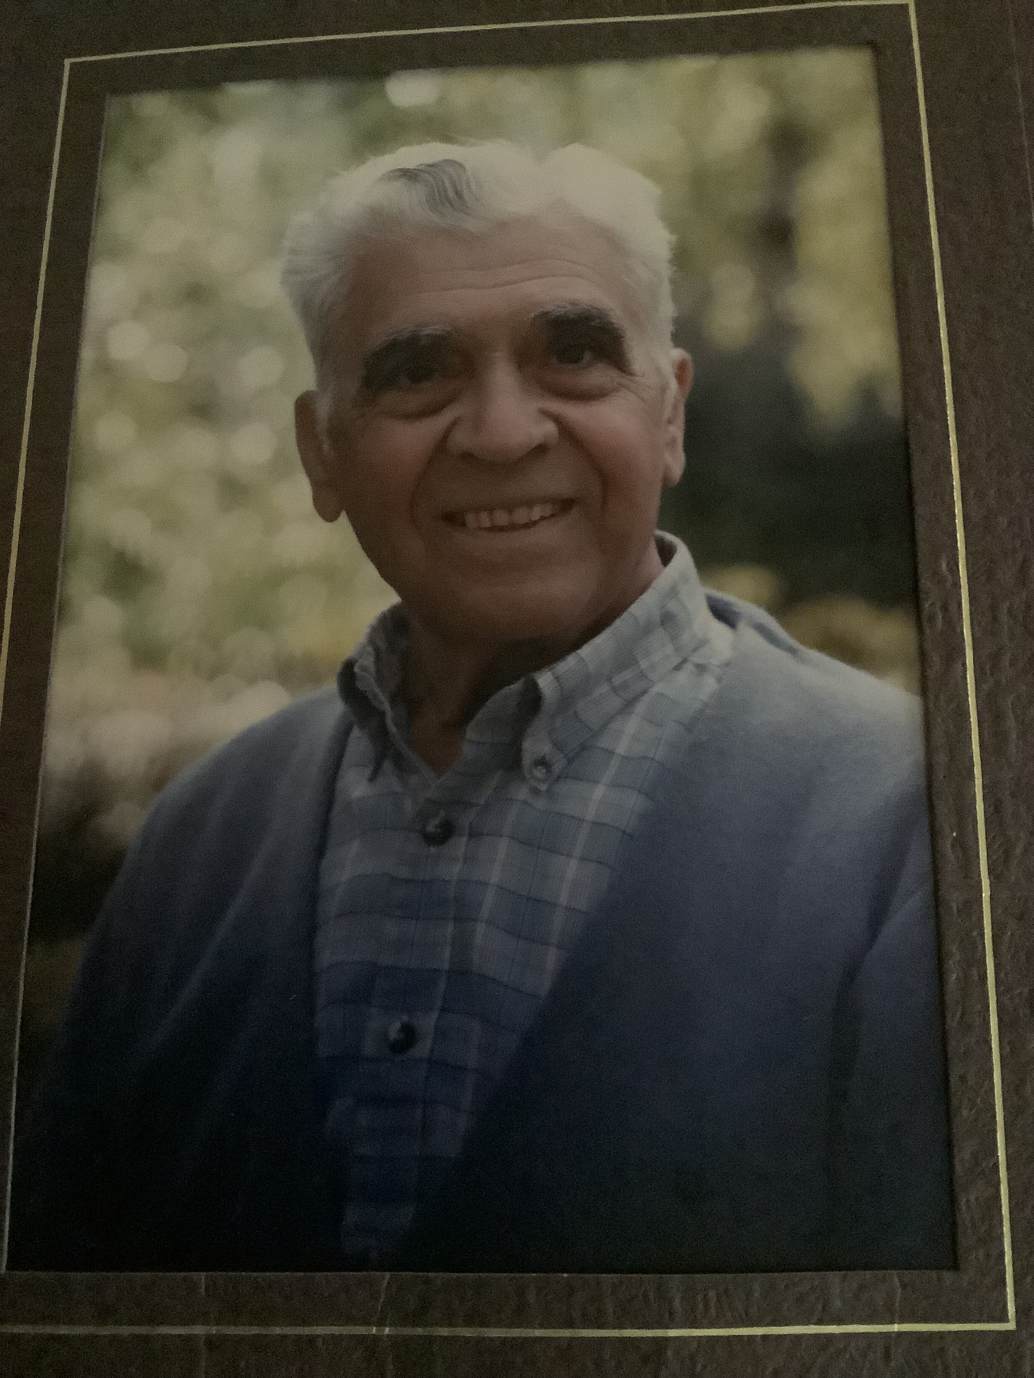
Gabriel (Gabe) Riggio: Liz

Slide 18
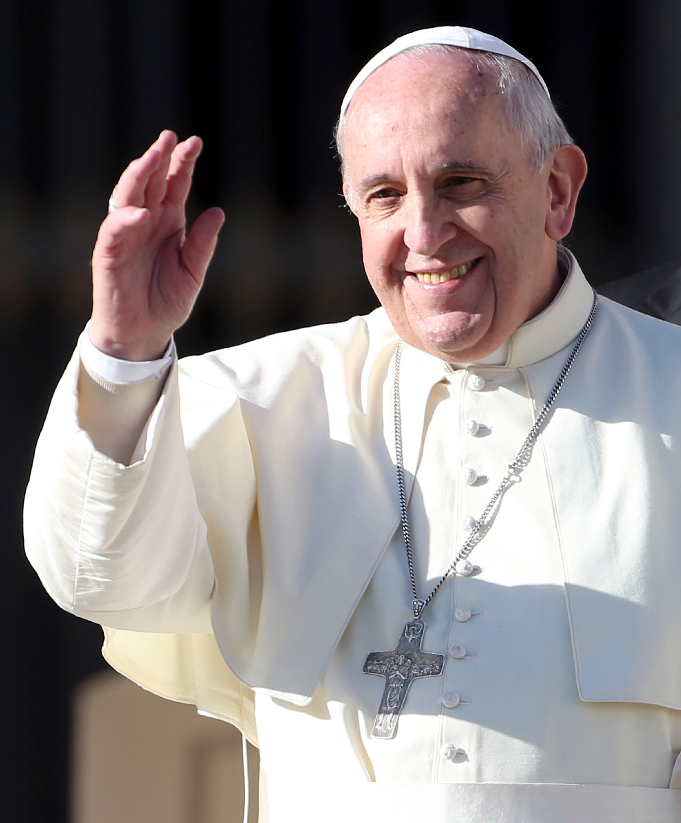
Pope Francis

Slide 19
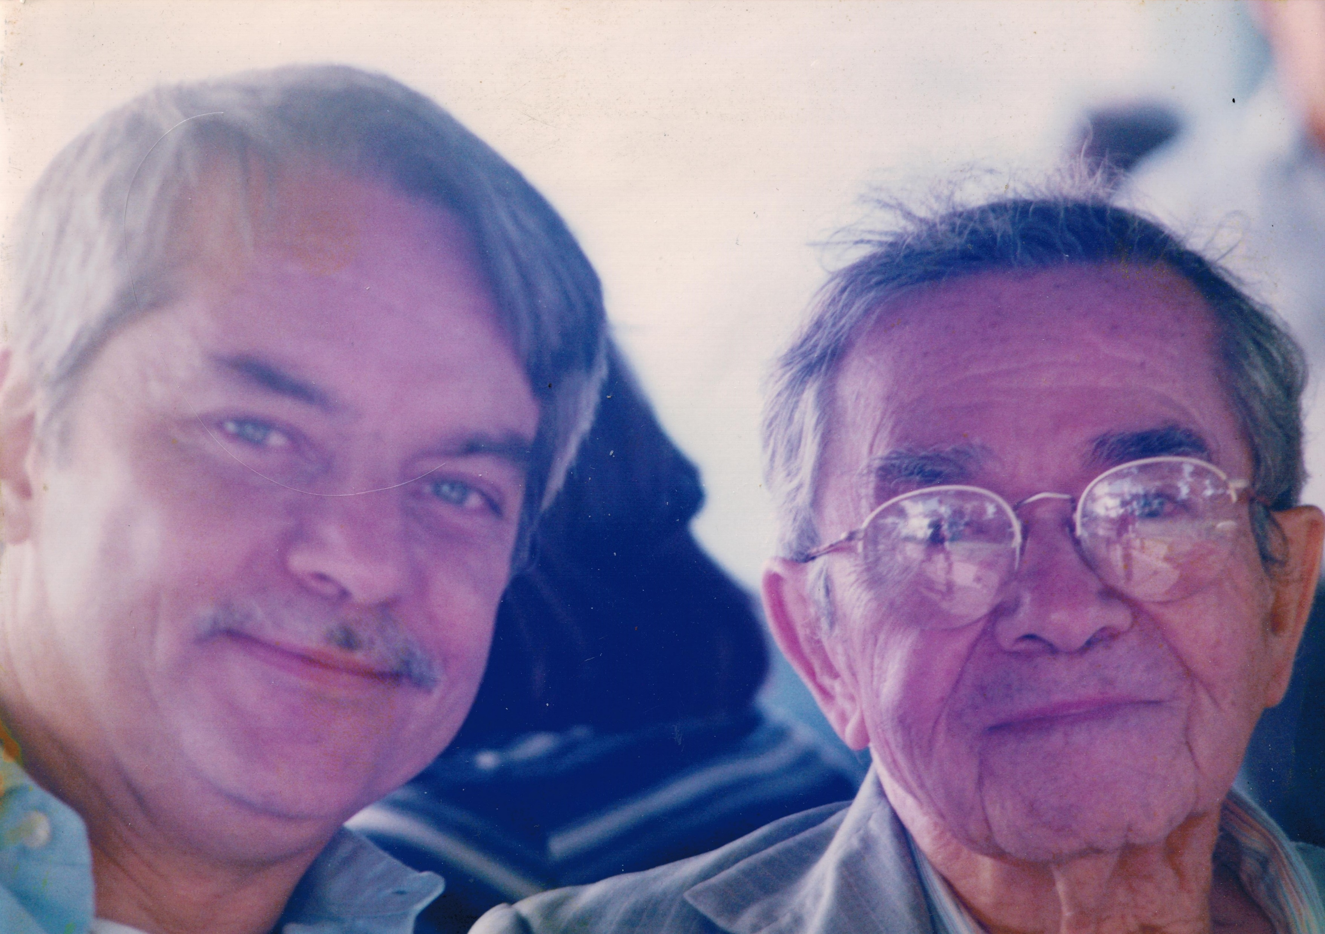
Roberto & Juan Manuel Jimenez

Slide 20
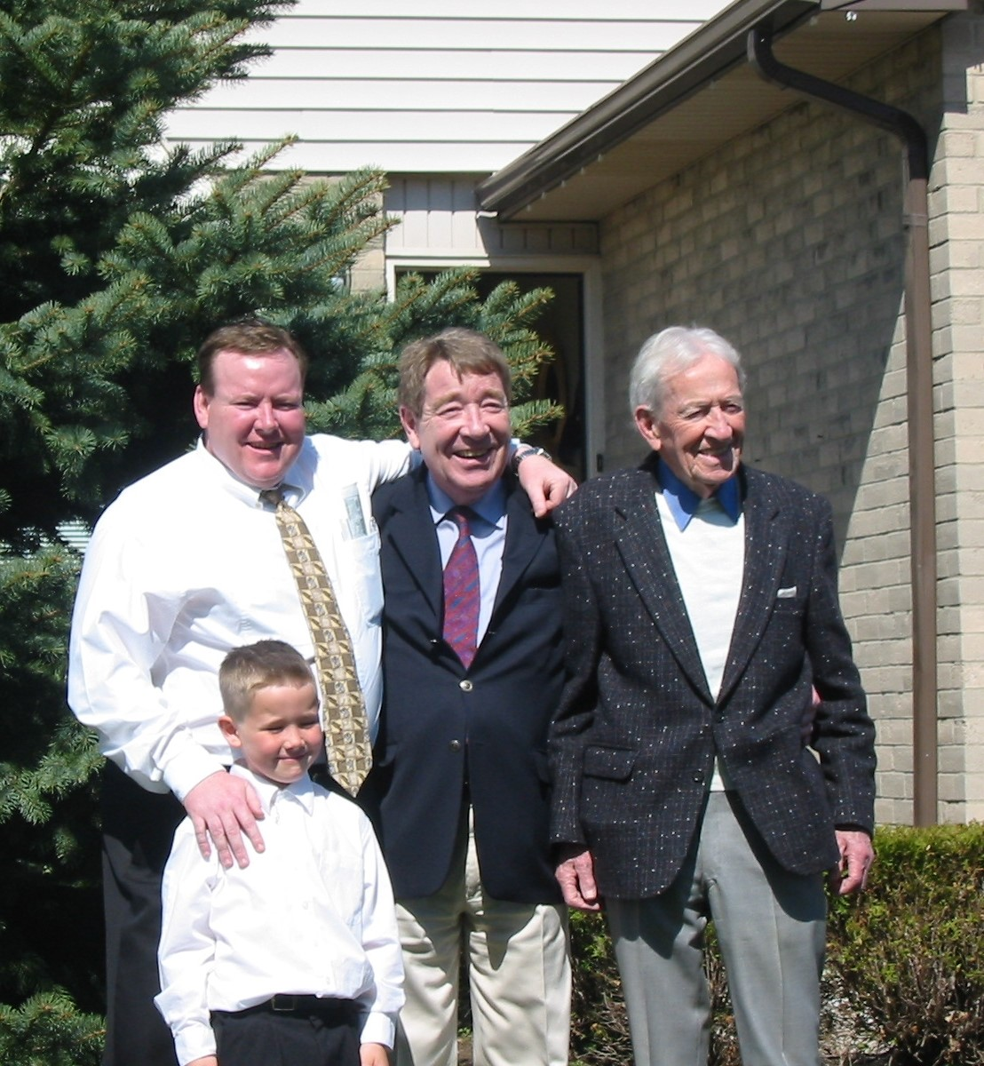
Connor, Paul, Bob & Martin Stone: Maryanne

Slide 21
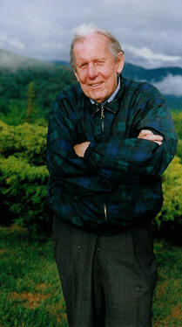
Thomas Berry

Slide 22
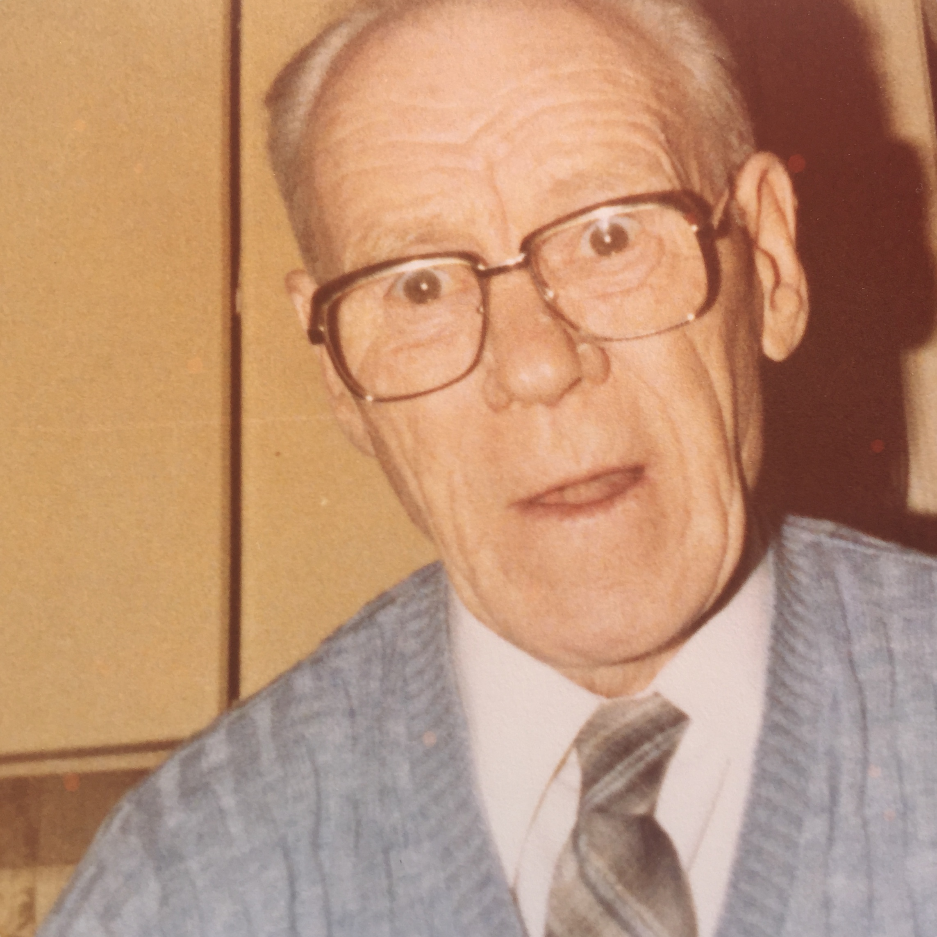
John Donnelly: Sharon

Slide 23
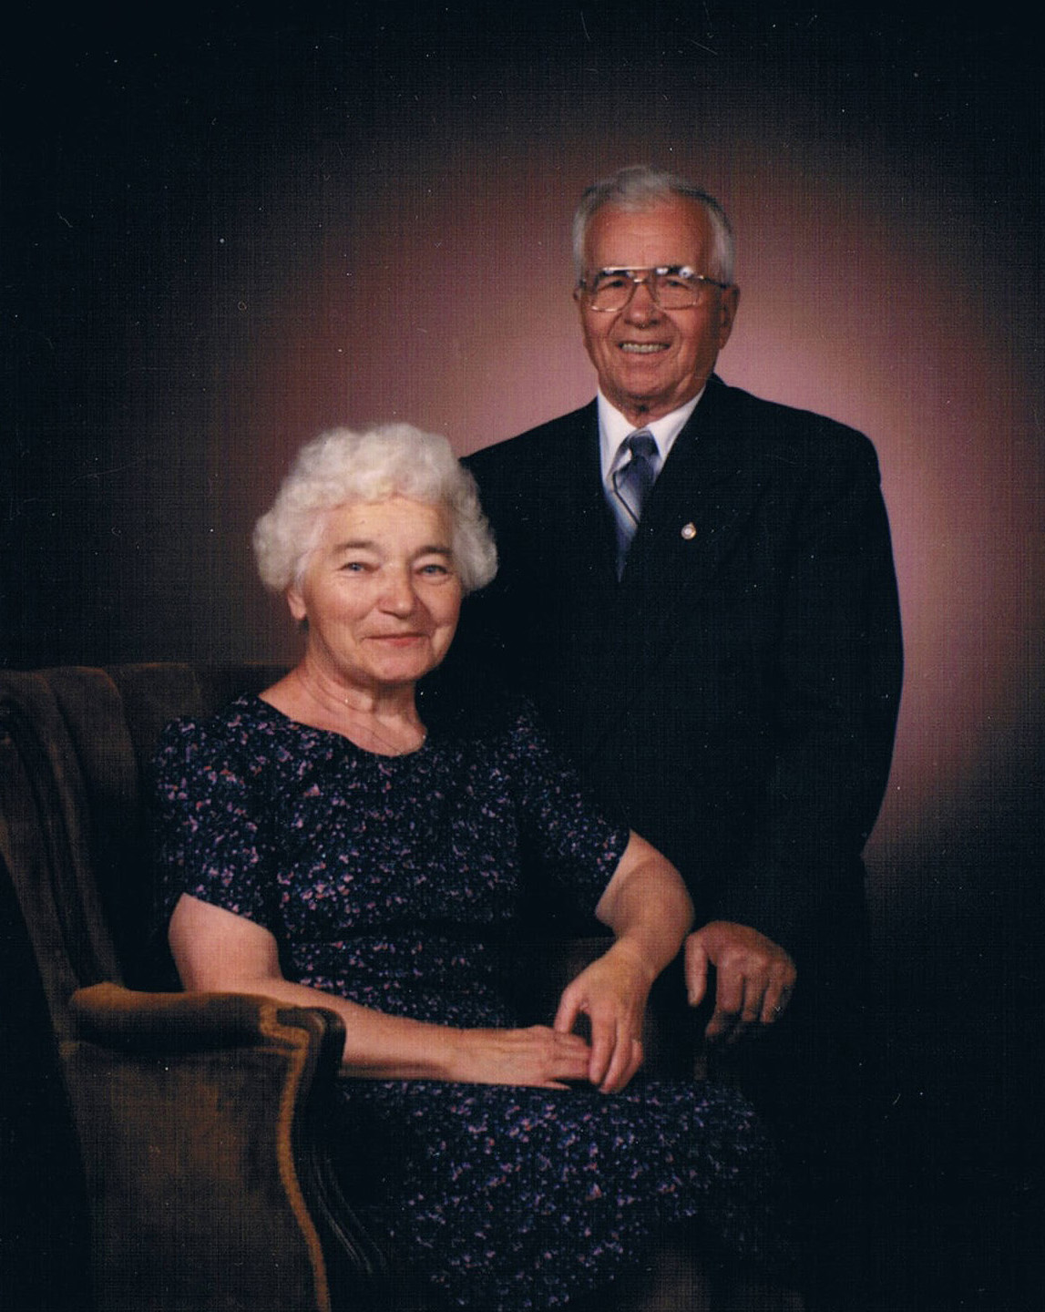
Mary & Peter Strepichuk: Sylvia

Slide 24
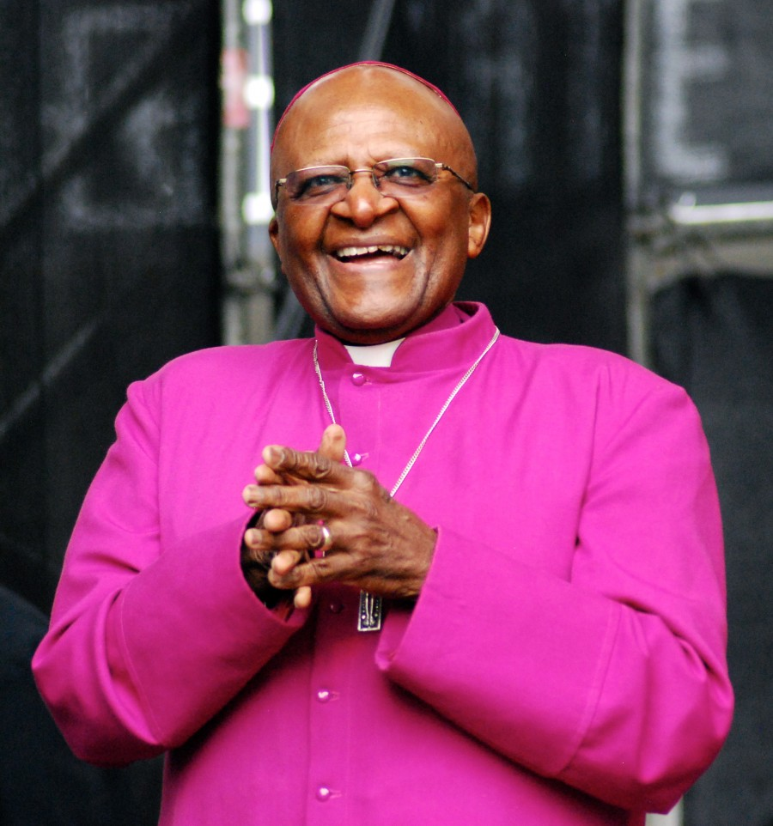
Bishop Tutu

Slide 25
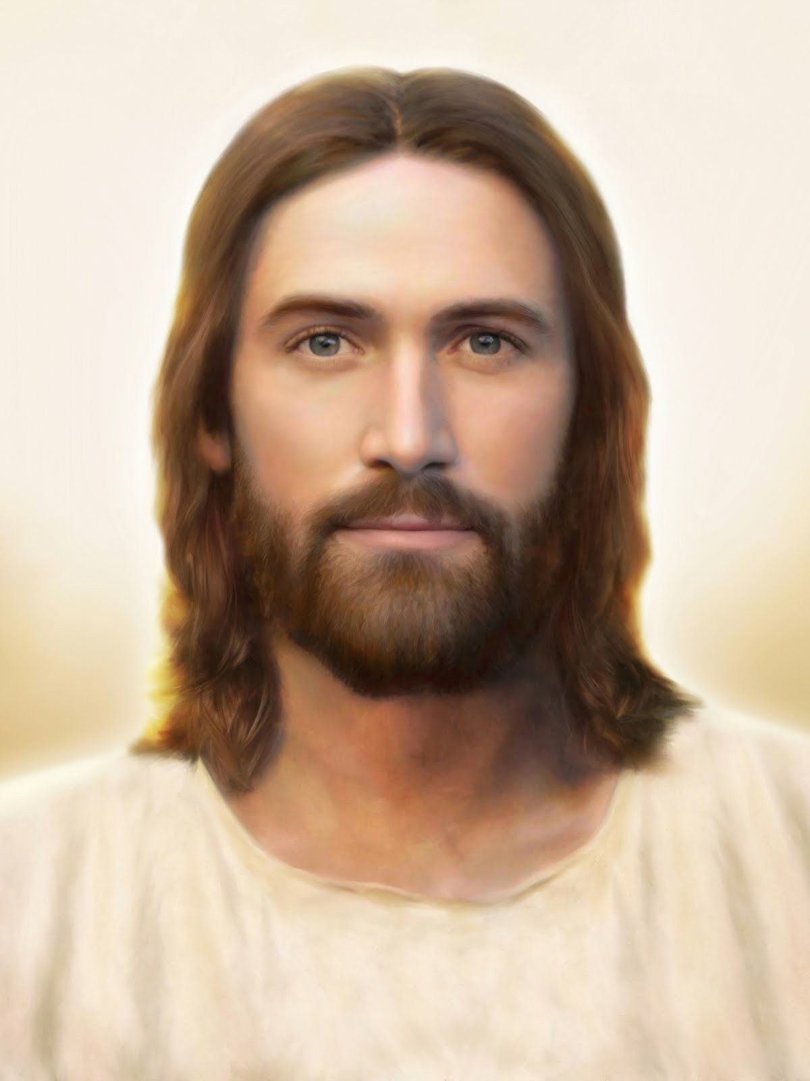
Jesus

Slide 26


