Slide 1

The Haudenosaunee (Iroquois Confederacy or Six Nations) Thanksgiving Address
The Haudenosaunee open and close every social and religious meeting with the Thanksgiving Address

Slide 2
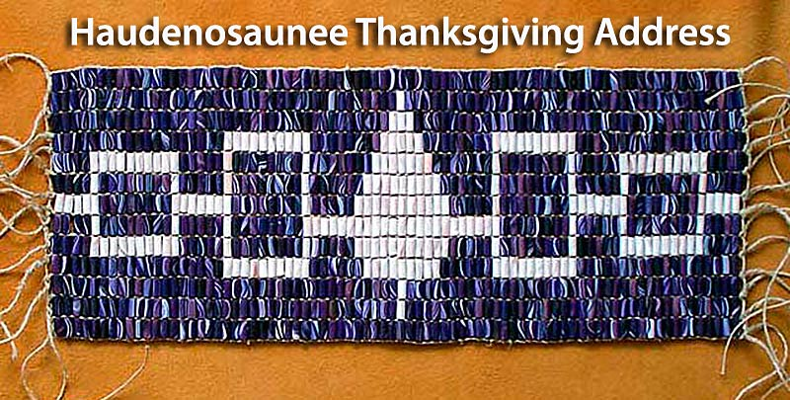
Today we have gathered, and we see that the cycles of life continue. We have been given the duty and responsibility to live in balance and harmony with each other and all living things…….
NOW OUR MINDS ARE ONE

Slide 3
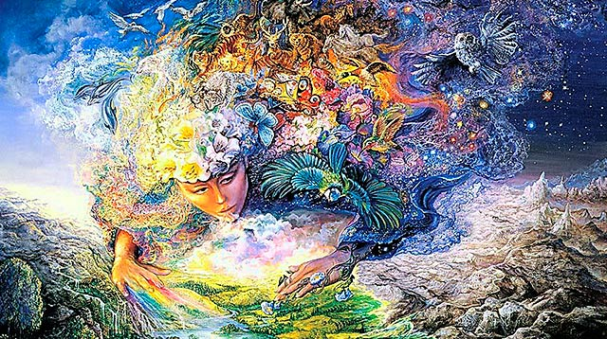
We are all thankful to our Mother, the Earth, for she gives us all that we need for life. She supports our feet as we walk about upon her.
NOW OUR MINDS ARE ONE

Slide 4
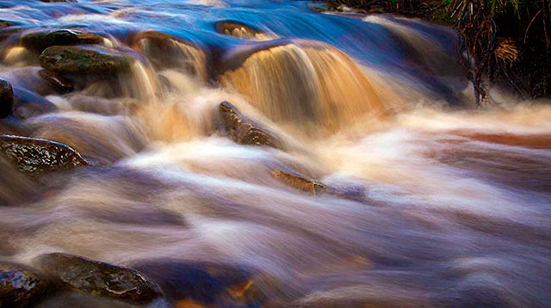
We give thanks to all the waters of the world for quenching our thirst and providing us with strength. Water is life.
NOW OUR MINDS ARE ONE

Slide 5
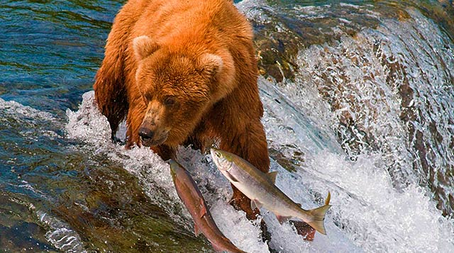
We turn our minds to all the Fish life in the water. They were instructed to cleanse and purify the water. They also give themselves to us as food.
NOW OUR MINDS ARE ONE

Slide 6
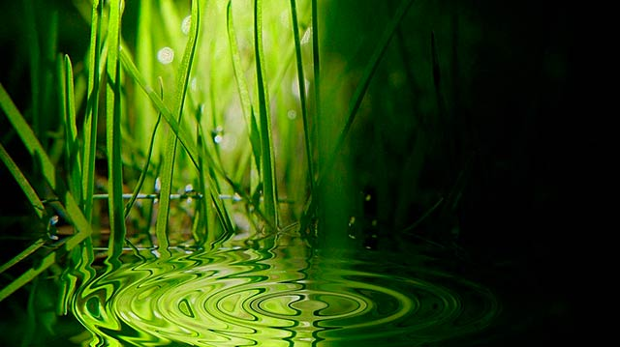
Now we turn toward the Plants. As far as the eye can see, the Plants grow, working many wonders. They sustain many life forms.
NOW OUR MINDS ARE ONE

Slide 7
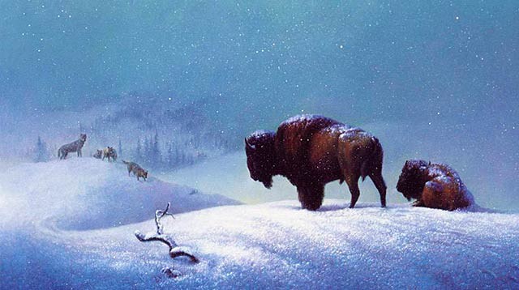
We gather our minds together to send our greetings and our thanks to all the Animal life in the world. They have many things to teach us as people.
NOW OUR MINDS ARE ONE

Slide 8
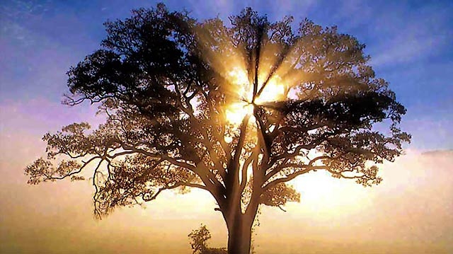
We now turn our thoughts to the Trees. The Earth has many families of Trees who have their own instructions and uses. Some provide us with shelter and shade, others with fruit, and beauty.
NOW OUR MINDS ARE ONE

Slide 9
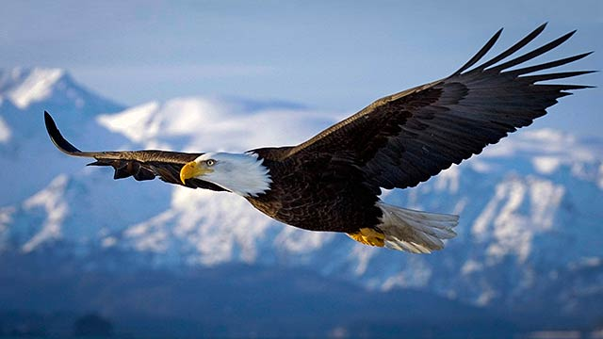
We put our minds together as one and thank all the Birds who move and fly about over our heads. The Creator gave them beautiful songs. Each day they remind us to enjoy and appreciate life. The Eagle was chosen to be their leader.
NOW OUR MINDS ARE ONE

Slide 10
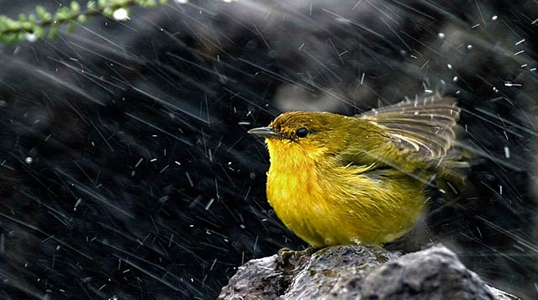
We are all thankful to the powers we know as the Four Winds. We hear their voices in the moving air as they refresh us and purify the air we breathe. They help us to bring the change of seasons.
NOW OUR MINDS ARE ONE

Slide 11
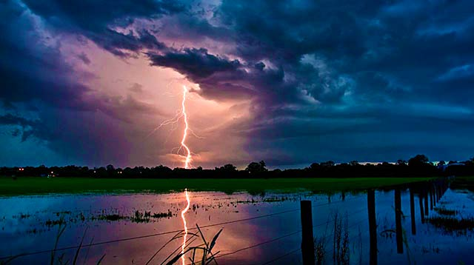
Now we turn to the west where our grandfathers, the Thunders live. With lightning and thundering voices, they bring with them the water that renews life.
NOW OUR MINDS ARE ONE

Slide 12
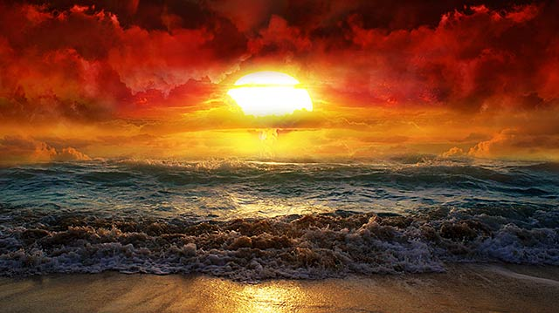
We now send our greetings and our thanks to our eldest Brother, the Sun. Each day without fail he travels the sky from east to west, bringing the light of a new day. He is the source of all the fires of life.
NOW OUR MINDS ARE ONE

Slide 13
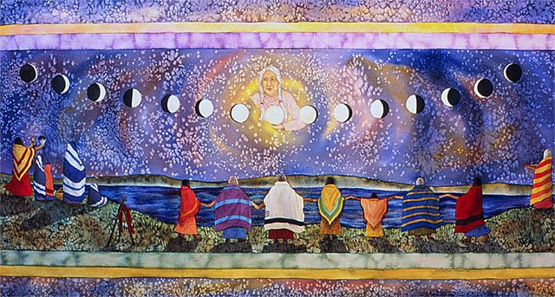
We put our minds together to give thanks to our oldest Grandmother, the Moon, who lights the night‐time sky. She is the leader of woman all over the world, and she governs the movement of the ocean tides.
NOW OUR MINDS ARE ONE

Slide 14
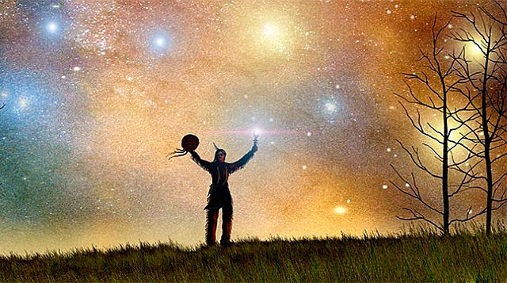
We give our thanks to the Stars who are spread across the sky like jewels. We see them in the night, helping the Moon to light the darkness.
NOW OUR MINDS ARE ONE

Slide 15
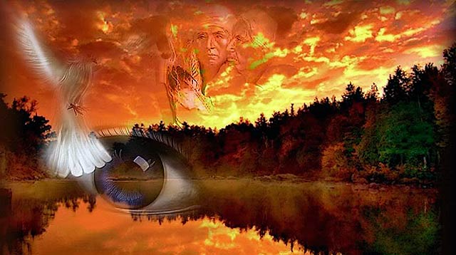
We gather our minds together to consider the Wisdom Keepers who have come to help the people throughout the ages. When we forget how to live in harmony, they remind us of the way we were instructed to live.
NOW OUR MINDS ARE ONE

Slide 16
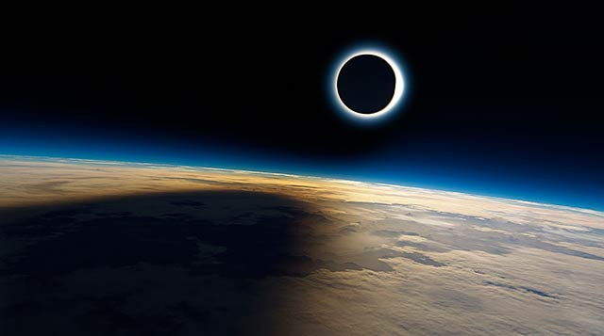
Now we turn our thoughts to the Creator and send our greetings and our thanks for all the gifts of Creation. Everything we need to live a good life is here on this Mother Earth.
NOW OUR MINDS ARE ONE

Slide 17
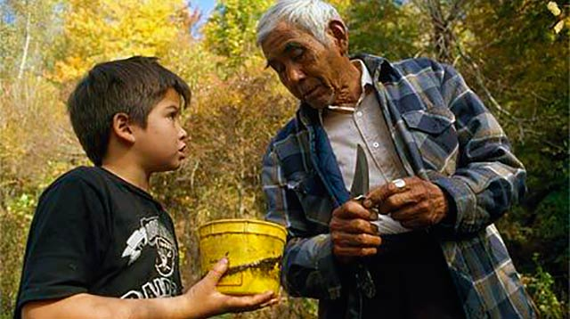
We have now arrived at the place where we end our words. Of all the things we have named, it is not our intention to leave anything out. If something has been forgotten, we leave it to each individual to send their greetings and their thanks in their own way.
NOW OUR MINDS ARE ONE

